Slide 1

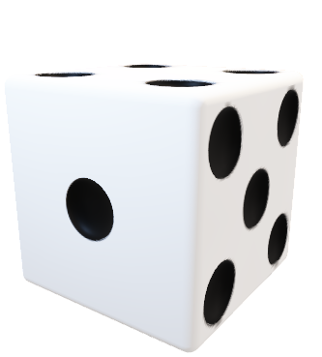
RichUp.io
Mariana Andrade 103823
Vicente Barros 97787
Multimodal Interaction
2023/24

Slide 2

RichUp.io
Application
Scenario
Gestures
Implementation
Limitations

Slide 3

RichUp.io
Application
Richup.io is a free online alternative to the classic board game Monopoly.
Roll Dices
Buy Houses
Trade with other players
Customize player’s character
Check House Information

Slide 4
RichUp.io
Application
Scenario
Gestures
Implementation
Limitations

Slide 5
RichUp.io
Scenario
#1: Rolling the Dice
Given a player is ready to take their turn
When the player performs a swiping gesture over the device’s sensor
Then the game should recognize this gesture as a dice roll and make the move

Slide 6
RichUp.io
Scenario
#2: Buying a Property
Given a player lands on an unowned property,
When the player makes a tapping gesture over an hand from another
Then it should be recognized as an intent to buy the property and deduct the property cost from the player's game currency.

Slide 7
RichUp.io
Application
Scenario
Gestures
Implementation
Limitations

Slide 8
RichUp.io
Gestures

Slide 9
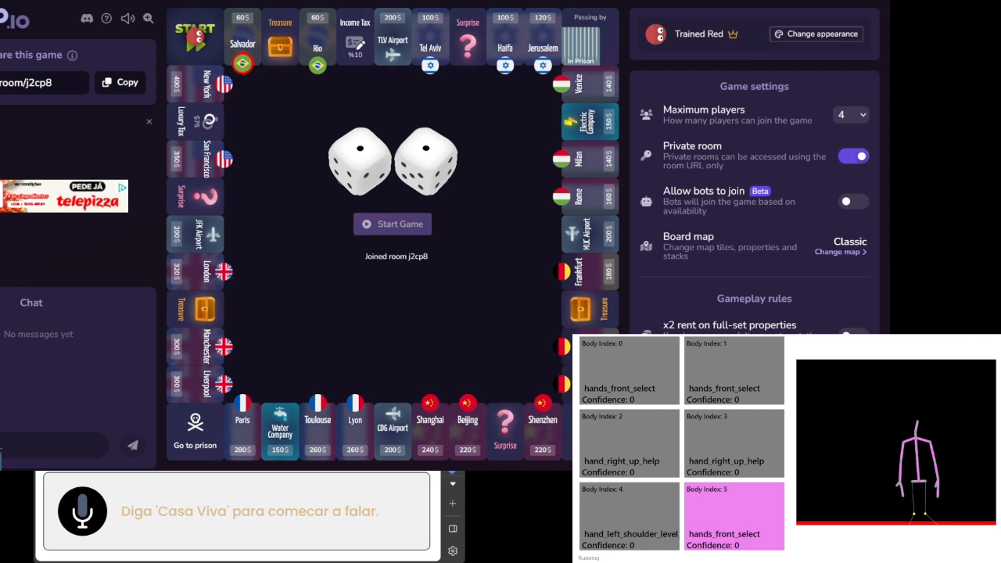
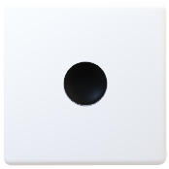
Help

Slide 10
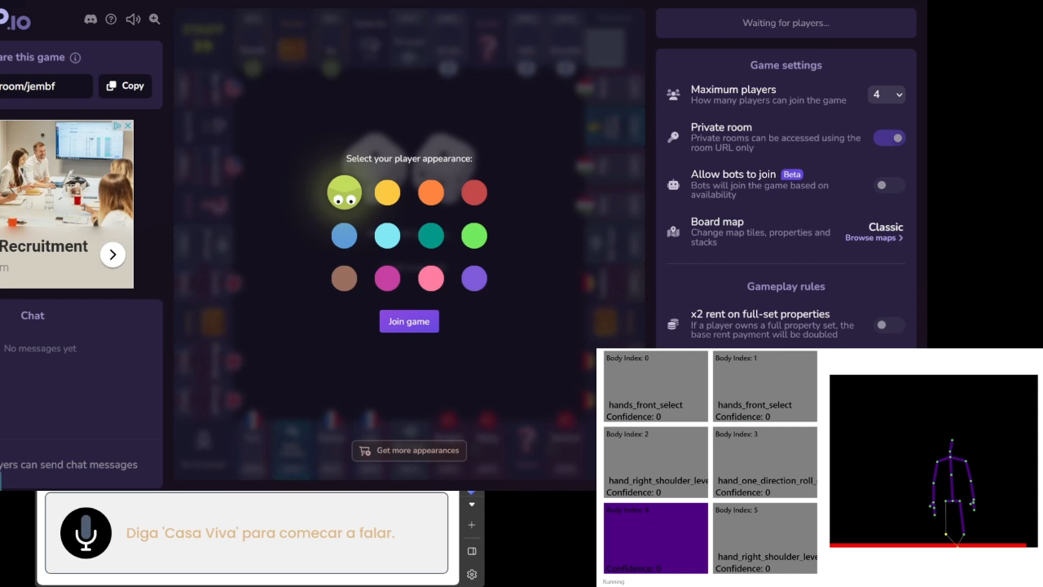
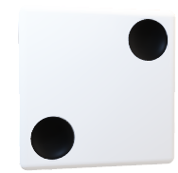
Colours Interaction

Slide 11
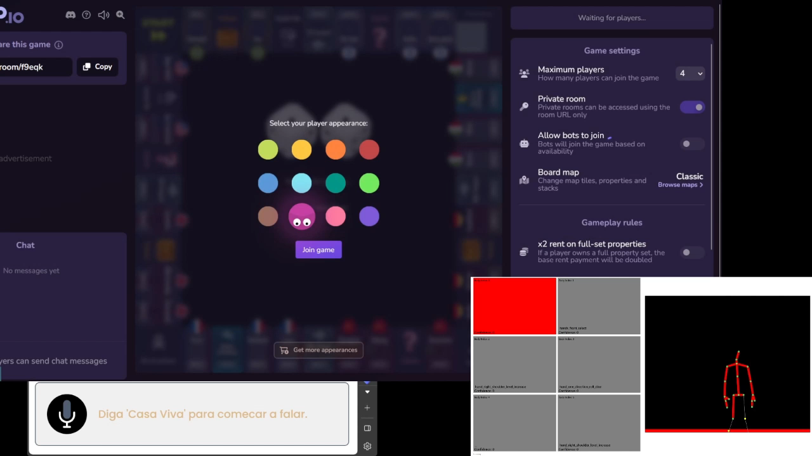
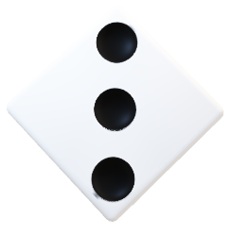
Full Colours Interaction

Slide 12
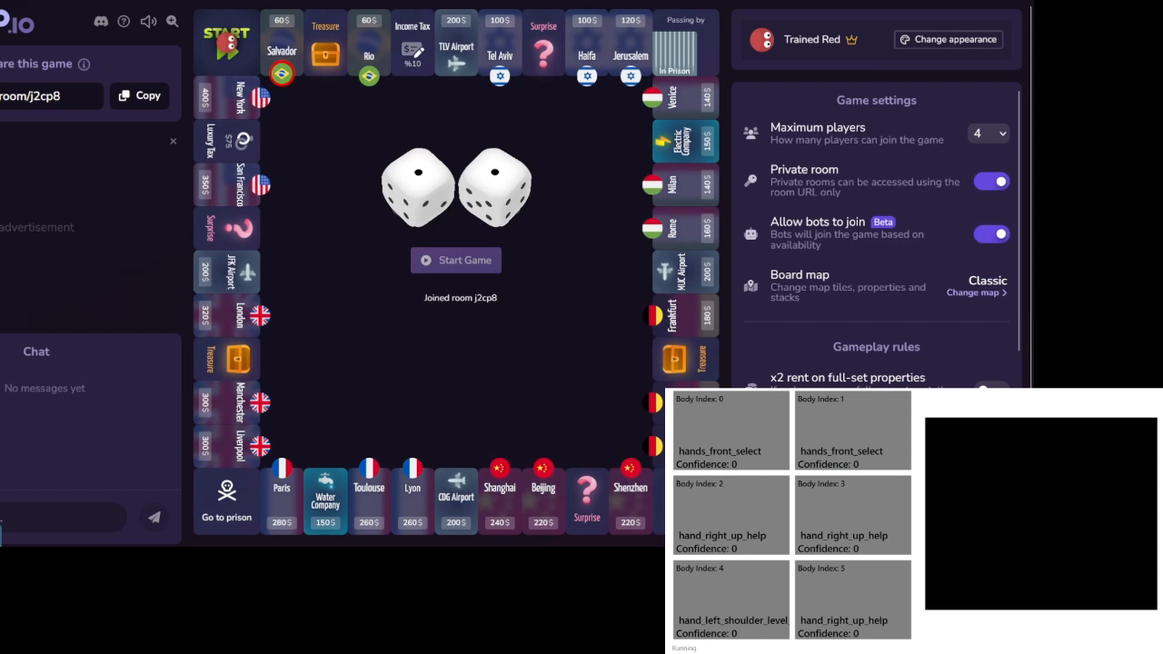
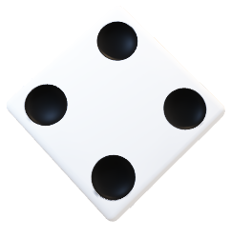
Roll Dice

Slide 13
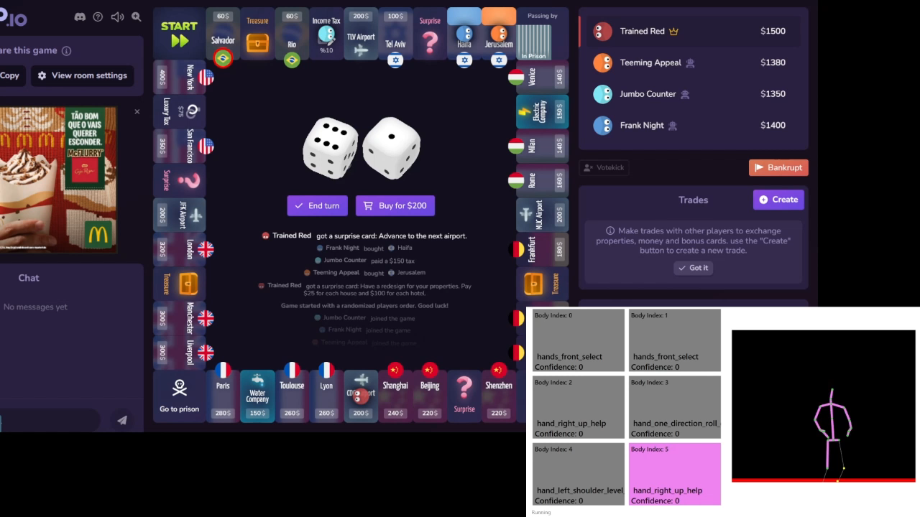
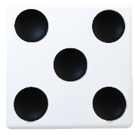
Buy House

Slide 14
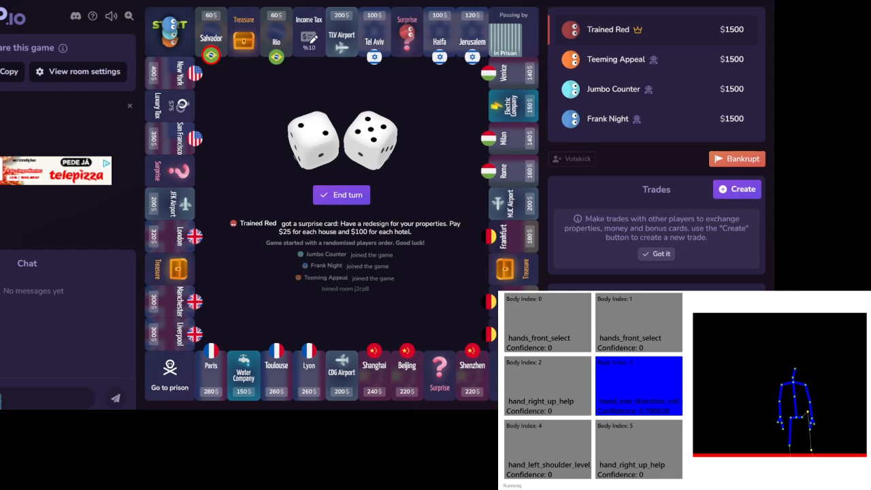
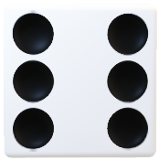
End Turn

Slide 15
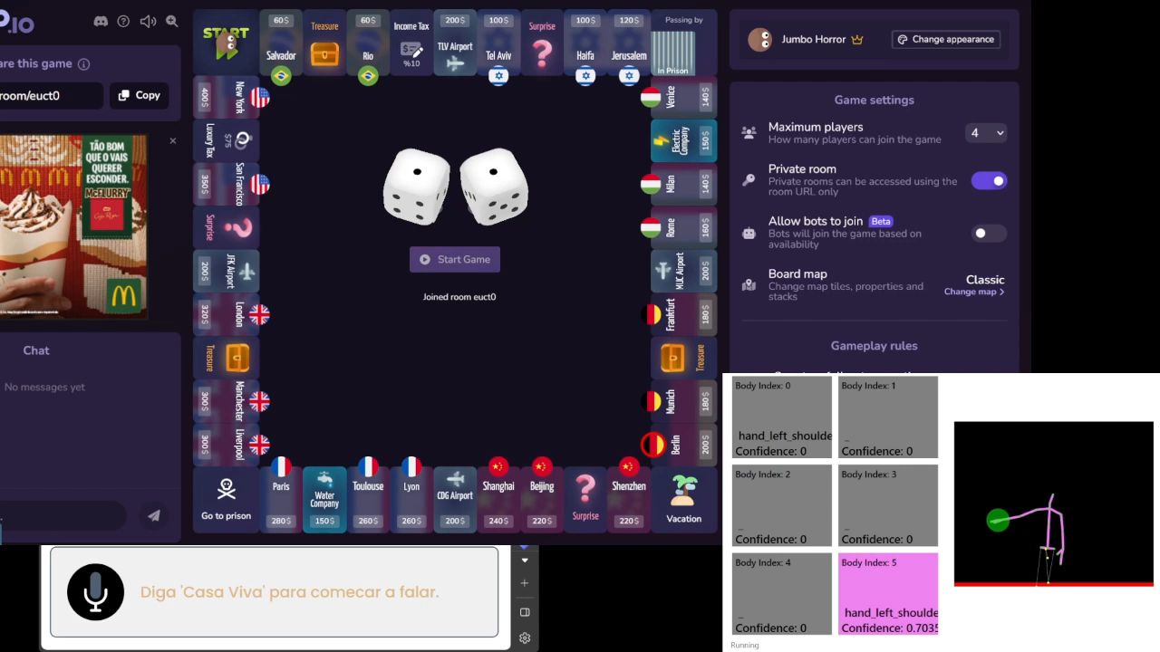
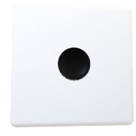
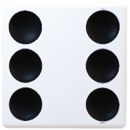
Houses Interaction

Slide 16
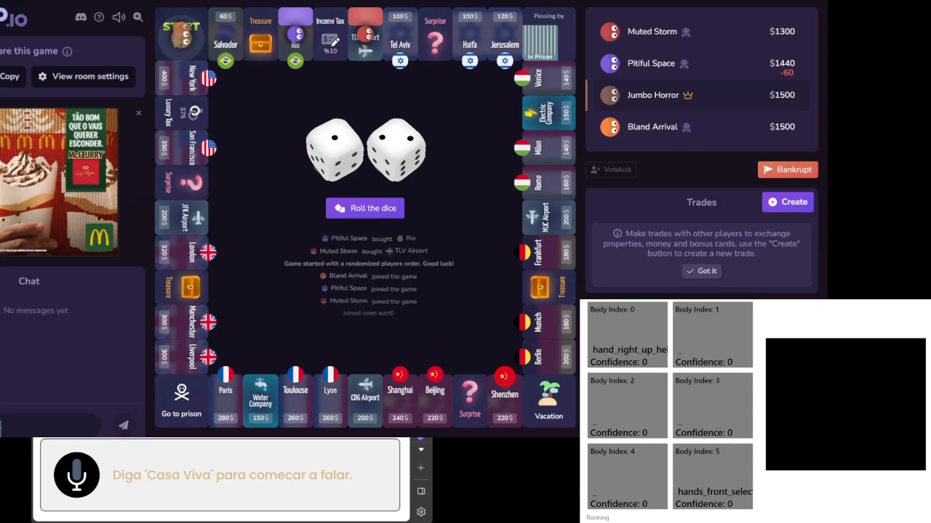
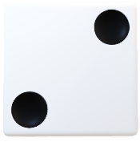
Give Up

Slide 17
RichUp.io
Application
Scenario
Gestures
Implementation
Limitations

Slide 18
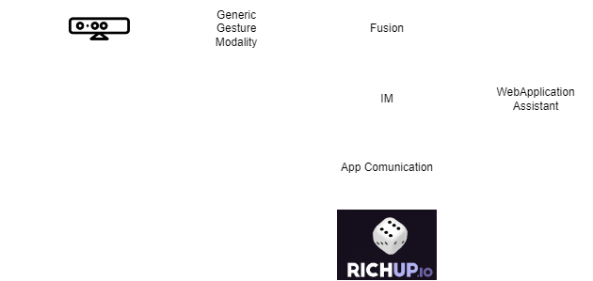
RichUp.io
Implementation

Slide 19
RichUp.io
Application
Scenario
Gestures
Implementation
Limitations

Slide 20
RichUp.io
Limitations
The main challenge was the recording in different places.
Even with a reasonable number of examples and the use of negative examples, the Kinect struggled to identify some gestures

Slide 21
Live Demo

